Slide 1
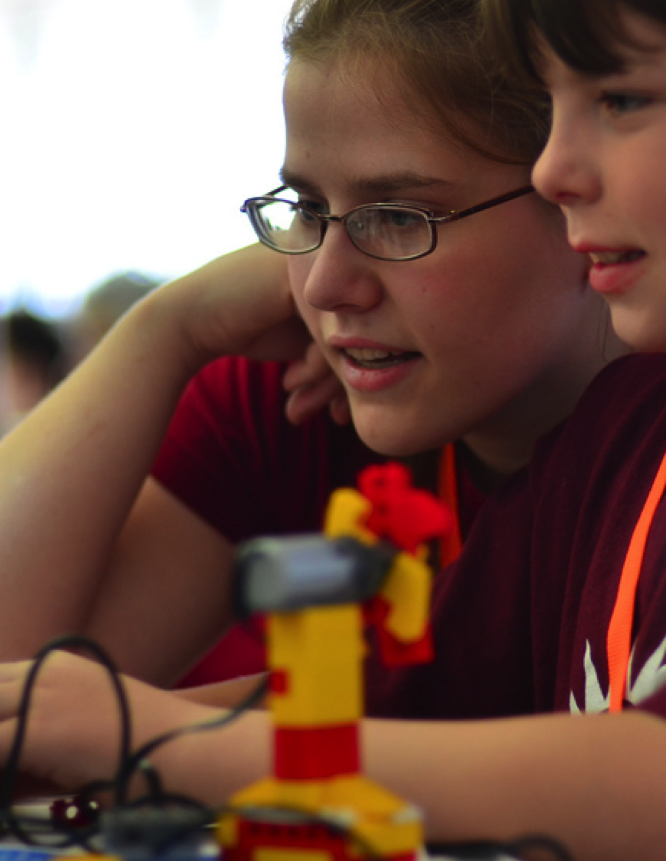
UNIT 6
HACKATHON
WHAT’S INCLUDED
YOU ARE HERE
PROJECT PITCH 114
PROJECT PLANNING 116
DESIGN SPRINT 120
PROJECT FEEDBACK 122
PROJECT CHECK-IN 124
UNFOCUS GROUP 126
SHOWCASE PREP 128
SHOWCASE 130
0
1
2
3
4
5
6
109

Slide 2
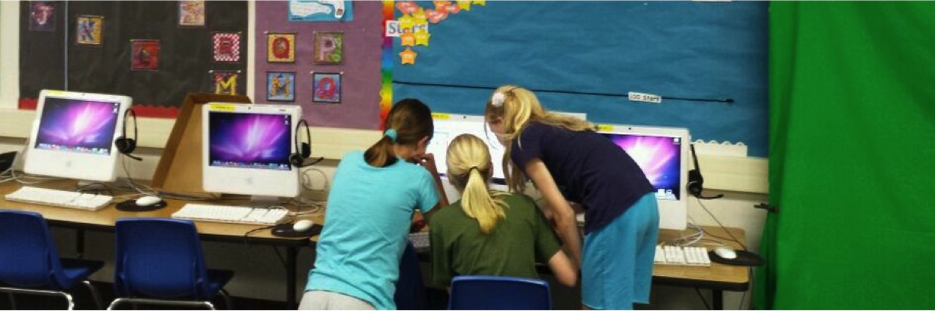
UNIT 6
OVERVIEW
THE “BIG IDEA”
School is done but
some students do not
seem to notice.
Busy debugging
their #scratch game. A team effort.
@Sheena1010
In this final unit, students will build on their creative computing experiences by engaging in the design of an open-ended project of their choosing. To help you and your students tackle this open-ended design experience, we were inspired to frame this unit as a hackathon. With its ethos of embracing just-in-time learning and problem solving, encouraging iterative planning-making-sharing, and celebrating a connected and collaborative environment, the hackathon is an ideal creative computing culminating experience.
LEARNING OBJECTIVES
KEY WORDS, CONCEPTS, & PRACTICES
Students will:
be introduced to the format of a hackathon event
demonstrate knowledge of computational concepts (sequence, loops, events, parallelism, conditionals, operators, data) and practices (experimenting and iterating, testing and debugging, reusing and remixing, abstracting and modularizing) by defining, developing, and presenting a personally meaningful, self-directed project
have multiple opportunities for collaboration by working in peer teams, sharing skills, and giving and receiving multiple rounds of feedback
hackathon
design sprint
project pitch
unfocus group
showcase
NOTES
This unit can accommodate either independent or collaborative group projects. Pick one option or allow students to choose.
110
Notes:
<numéro>

Slide 3
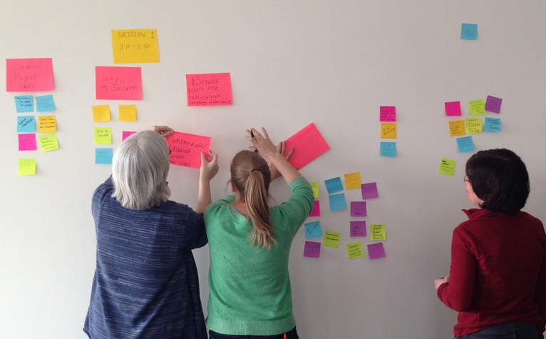
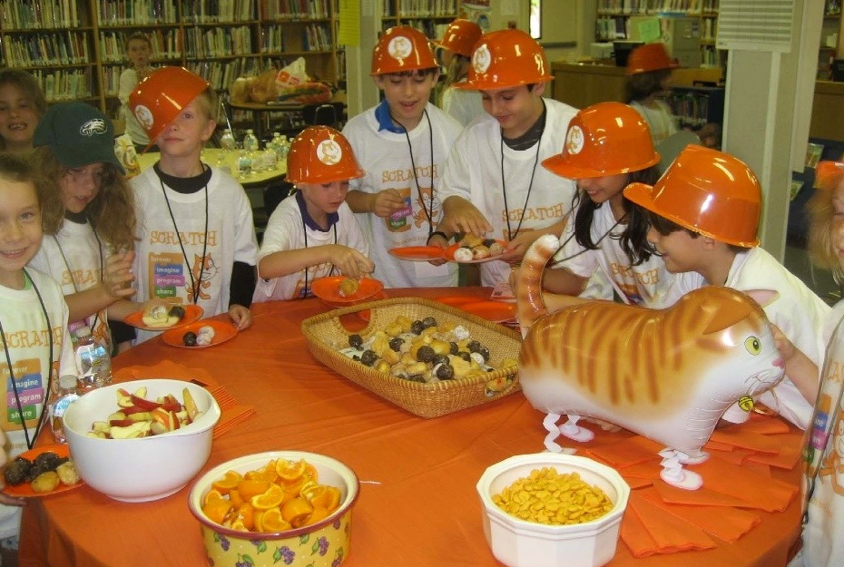
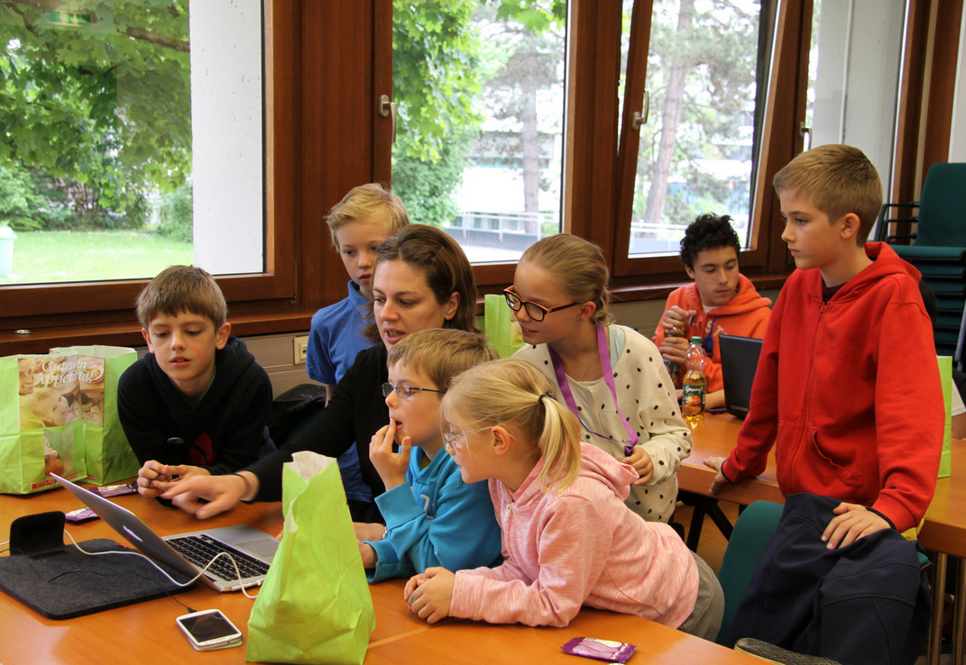


WHAT IS A HACKATHON?
“Hack” has a negative connotation to some – but it has a long history of standing for playfulness, curiosity, persistence, and creativity. One of our favorite definitions frames “hack” as “an appropriate application of ingenuity”. With this definition, what better capacity for young learners than learning how to “hack”?
A hackathon takes the playful ingenuity of hacking – and situates it in an intensely focused and time-limited context. In this unit, learners will brainstorm an idea, develop a project, and showcase a final prototype using an iterative plan-make-share cycle.
Hackathons provide excellent opportunities for learners to invent their own personally meaningful and relevant projects to work on, which can be developed as independent final projects or in collaborative teams. It is a chance for students to demonstrate their knowledge in Scratch, expand upon current skills, and develop and test ideas within a collaborative, creative, flexible, and playful learning environment.
THE “BIG IDEA”
PLAN
HOW DOES IT WORK?
Throughout the duration of the hackathon, students will engage in iterative cycles in which they PLAN, MAKE, and SHARE. This iterative cycle encourages students to engage in meaningful acts of ideation, creation, and reflection.
SHARE
MAKE
PLAN
MAKE
SHARE
What do you want to work on? Brainstorm ideas and prepare a plan of action!
Design and develop project creations with
resources and help from others.
Share your project with others and gather feedback to guide your next steps!
111
Notes:
<numéro>

Slide 4
POSSIBLE PATH
The hackathon-inspired activities for this unit are designed to challenge students to build up a more complex project within an open-ended and collaborative learning environment. All of the important culture-building we’ve been doing – encouraging risk-taking and persistence, recognizing failures as learning opportunities, focusing on process over product, and cultivating a culture of cooperation and fun – culminates in this unit.
To help you get started, we have included a suggested sequence of activities that follow the plan-make-share design cycle.
PROJECT PITCH
PLANNING PROMPTS
DESIGN
SPRINT
START HERE
Before diving into your project, take some time to prepare a plan of action.
Dive into your project creation with this open-ended design sprint.
Pitch your ideas, interests, or skills to form a project team!
SKILL SHARE
PROJECT
CHECK-IN
PROJECT FEEDBACK
DESIGN
SPRINT
Take a moment to reflect on your project feedback and regroup before continuing.
What is going well in your project and what still needs adjustment?
Keep making progress with your project as you move into the second round of design.
PROJECT
CHECK-IN
DESIGN
SPRINT
UNFOCUS
GROUP
Take a moment to reflect on your project feedback and regroup before continuing.
Final round of design!
Formulate and share project feedback with your critique group.
SHOWCASE
SHOWCASE
PREP
An event to celebrate all of your hard work and finished projects!
Use this time to make last-minute project edits and to prepare for the hackathon showcase.
112
Notes:
<numéro>

Slide 5

Notes:
<numéro>

Slide 6


PROJECT PITCH
OBJECTIVES
By completing this activity, students will:
brainstorm project ideas based on personal interests
pitch ideas, interests, and skills to form project teams
UNIT 6 ACTIVITY
_{SUGGESTED TIME}
30–45 MINUTES
ACTIVITY DESCRIPTION
RESOURCES
Introduce students to the concept of a pitch. With a pitch, students can either announce a project idea in order to recruit other team members, or they can promote their interests, skills, or talents, in order to be recruited by other teams.
Distribute the Pitch handout, giving students time to brainstorm and to respond on the handout. Some students already may have a project idea or have identified a specific interest or skill they want to share or further explore. Let students know that if they don’t have a specific project idea or interest, they will have an opportunity to join another team. Optionally, have students review inspiration projects identified during the Unit 1 My Studio activity.
Give each student a chance to pitch to the rest of the group. Ask people to line up if they want to pitch, and give them thirty seconds each to describe their project, interest, or skill.
Provide time for students to form project groups of 3 or 4 people. Optionally, have students write their names and project interests on sticky notes that can be arranged and sorted on a wall to facilitate team-building.
Pitch handout
sticky notes (optional)
REFLECTION PROMPTS
What has been your favorite project to work on so far?
What kinds of projects are you interested in creating next?
What knowledge, skills, or talents could you contribute to a project?
REVIEWING STUDENT WORK
Did each student get a chance to pitch their idea or interests?
Did each student find a project team to join?
NOTES
NOTES TO SELF
Students can be enormously valuable in providing support and guidance to each other throughout all of the Scratch sessions, and particularly during the hackathon sessions. Encouraging young people to share their knowledge and skills with others makes things easier for the facilitator, but can also significantly deepen creators’ learning and understanding.
114
Notes:
<numéro>

Slide 7
PROJECT PITCH
PROJECT PITCH BY: __________________________________________________
Use the prompts below to brainstorm ideas for projects you’re interested in working on during the hackathon. You will have 30 seconds to pitch your ideas, interests, and skills to the rest of the group!
MY FAVORITE PROJECT
What has been your favorite project to work on so far? What made this project stand out for you?
MY HACKATHON PROJECT IDEA
What kinds of projects are you interested in creating next?
MY SKILLS AND INTERESTS
SKILLS IN SCRATCH
What knowledge, skills, or talents would you like to contribute to a project?
Notes:
<numéro>

Slide 8
PROJECT PLANNING
OBJECTIVES
By completing this activity, students will:
identify an appropriately-scoped project to work on
develop an outline of activities or tasks required to complete the project
generate a preliminary list of resources required to complete the project
UNIT 6 ACTIVITY
_{SUGGESTED TIME}
30–45 MINUTES
ACTIVITY DESCRIPTION
RESOURCES
Taking some time at the start of the final project to explore ideas, identify tasks involved in completing the project, and list what is (and isn’t) already known can be very beneficial for successful project completion.
Divide the group into project teams. Optionally, distribute the Project Planning and Project Sketches handouts to each team or individual.
Review different elements for planning projects (project sketches, outline of tasks, list of resources, storyboards/wireframes). Give the teams 15 minutes to brainstorm ideas, plans, and resources for their projects. Students who already have a clear concept and plan are welcome to start working on their project design.
Optionally, collect the completed Project Planning and Project Sketches handouts at the end of this activity to return to students at the beginning of Design Sprint sessions.
Project Planning handout
Project Sketches handout
REFLECTION PROMPTS
What project do I want to create?
What steps will I take to develop my project?
What resources (e.g., people, sample projects) do I already have to develop my project?
What resources (e.g., people, sample projects) might I need to develop my project?
REVIEWING STUDENT WORK
Is the project appropriately scoped for the amount of time and resources available for this hackathon?
How can you make resources accessible to students who need them?
NOTES
NOTES TO SELF
Although planning is helpful, it shouldn’t be all-consuming or the only way of doing things. Different students will want and need to plan and tinker to different extents – and different phases of the project will require different approaches. Multiple design and development styles should be encouraged and accommodated.
116
Notes:
<numéro>

Slide 9
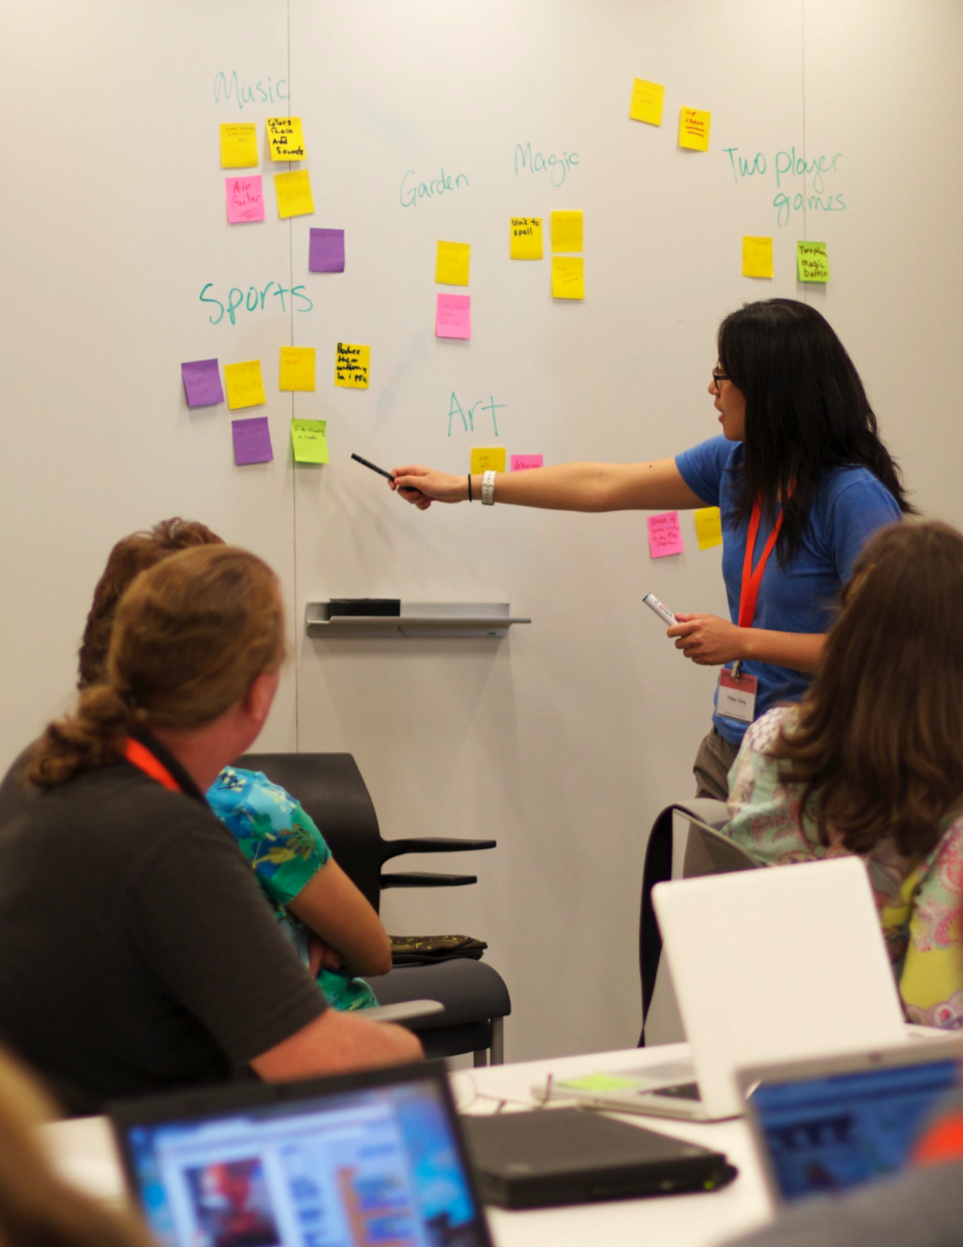
Notes:
<numéro>

Slide 10
PROJECT PLANNING
PROJECT PLANS BY: _________________________________________________
Use the prompts below to start thinking about the elements needed to develop your project.
MY PROJECT
Describe the project you want to create.
List the steps needed in order to create your project.
MY RESOURCES
What resources (e.g., people, sample projects) do you already have?
What resources (e.g., people, sample projects) might you need to develop your project?
Notes:
<numéro>

Slide 11
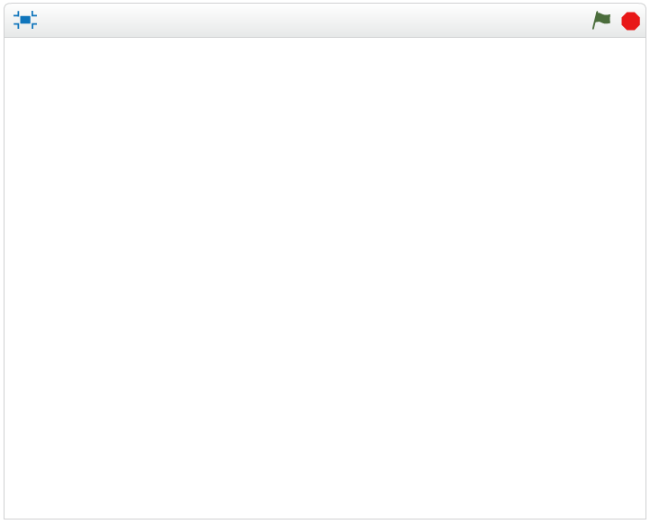
PROJECT SKETCHES
PROJECT SKETCHES BY: _______________________________________________
Use the space below to draw sketches of what your project will look like!
MY PROJECT SKETCHES
What’s happening? What are the important elements?
What’s happening? What are the important elements?
What’s happening? What are the important elements?
What’s happening? What are the important elements?
Notes:
<numéro>

Slide 12

DESIGN
SPRINT
OBJECTIVES
By completing this activity, students will:
use computational concepts and practices to further develop a Scratch project of their choosing
UNIT 6 ACTIVITY
_{SUGGESTED TIME}
45–60 MINUTES
ACTIVITY DESCRIPTION
RESOURCES
Introduce students to the concept of a design sprint, which is a specified amount of time dedicated to working intensely on developing projects.
Ask students to write down goals for this session using the Project Check-In activity or by responding to the reflection prompts in their design teams or in their design journals. Give students their completed Project Planning, Project Feedback, and Unfocus Group handouts to guide them in reflecting on original project goals and to encourage them to make plans for refinement based on feedback.
Give students self-directed time to work on their projects. Introduce and distribute additional support resources as needed. In addition to peer support, having a collection of readily-available support resources can help students continue to make progress. Sample projects on the Scratch website (http://scratch.mit.edu) can provide ideas, and additional resources can be found on the ScratchEd website (http://scratched.gse.harvard.edu).
Optionally, ask students to post their project drafts in a class studio.
additional resources (e.g., sample projects, handouts, Scratch Cards, craft material)
REFLECTION PROMPTS
What part of your project will you be working on today?
What might you need help with in order to make progress?
REVIEWING STUDENT WORK
Are individuals or groups making reasonable progress?
What feedback or suggestions do you have for the projects?
NOTES
NOTES TO SELF
All design activities are constrained – by time, by resources, by our own abilities at a given moment – and compromises may need to be made. The open-ended designing sessions are a great opportunity to have conversations with students about the essential elements of their projects. What are the most important aspects of the projects? What can reasonably be accomplished in the remaining time?
120
Notes:
<numéro>

Slide 13
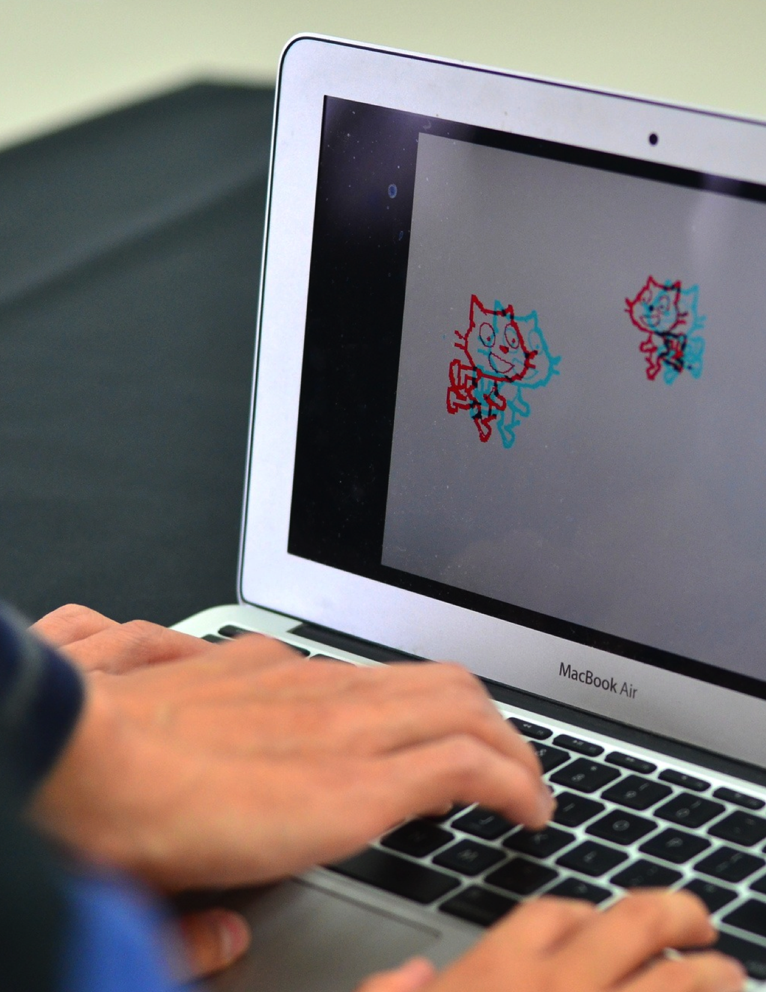
Notes:
<numéro>

Slide 14
PROJECT
FEEDBACK
OBJECTIVES
By completing this activity, students will:
will work together in small critique groups to give each other preliminary feedback on their projects
test projects-in-progress
formulate and share feedback for others
UNIT 6 ACTIVITY
_{SUGGESTED TIME}
30–45 MINUTES
ACTIVITY DESCRIPTION
RESOURCES
Divide the group into feedback teams of 3-4 people, so that their feedback team members are not also members of their project team. Optionally, have students gather in their critique groups from the Unit 0 Critique Group activity.
Distribute the Project Feedback handout to each person, and review the different handout elements. Ask students to fill out the top portion of the handout with their name and project title.
Ask students to spend 10 minutes reviewing each project in their feedback team and critiquing the project draft using the Red, Yellow, Green feedback questions. When the review is complete, each student will have received feedback on their project from the other members of their feedback group.
After all the feedback rounds have ended, give students time to meet with their project team members to review the feedback and reflect on which suggestions they want to incorporate into their project during the next Design Sprint session. Optionally, collect the completed Project Feedback handouts at the end of this activity to return to students at the beginning of the Project Check-In activity or Design Sprint sessions.
Project Feedback handout
REFLECTION PROMPTS
What aspects of your project could someone give you feedback about?
What feedback, if any, do you plan to incorporate into your project next?
REVIEWING STUDENT WORK
Did each student have opportunities to give and receive feedback from various sources?
Did each student complete the Project Feedback handout?
NOTES
NOTES TO SELF
Different people will provide different perspectives on the project-in-progress. Create opportunities for learners to get feedback from a variety of sources, including themselves!
122
Notes:
<numéro>

Slide 15
PROJECT
FEEDBACK
FEEDBACK FOR: ___________________________________________________
PROJECT TITLE: ___________________________________________________
RED, YELLOW, GREEN
FEEDBACK BY
[RED] What is something that doesn’t work or could be improved?
[YELLOW] What is something that is confusing or could be done differently?
[GREEN] What is something that works well or you really like about the project?
PARTS OF THE PROJECT THAT MIGHT BE HELPFUL TO THINK ABOUT:
Clarity: Did you understand what the project is supposed to do?
Features: What features does the project have? Does the project work as expected?
Appeal: How engaging is the project? Is it interactive, original, sophisticated, funny, or interesting? How did you feel as you interacted with it?
Notes:
<numéro>

Slide 16

PROJECT
CHECK-IN
OBJECTIVES
By completing this activity, students will:
review project progress and feedback
develop an outline of activities or tasks required to complete the project
generate a list of resources required to complete the project
UNIT 6 ACTIVITY
_{SUGGESTED TIME}
15–30 MINUTES
ACTIVITY DESCRIPTION
RESOURCES
In this activity, students will perform a project check-in, where they will update fellow team members about their design progress so far and outline a plan for an upcoming design sprint based on feedback received. Optionally, give students or groups a Project Check-In handout to guide them during this activity.
Divide the group into project teams. Optionally, redistribute to students their completed Project Planning, Project Feedback, and Unfocus Group handouts.
Give teams time to reflect back on original project goals and acquired feedback. Invite students to outline next steps and plans for project refinement for an upcoming design sprint.
Project Check-In handout
REFLECTION PROMPTS
What has been your favorite part of the process so far?
What parts of your project still need to be worked on?
What parts of your project will you be working on next?
What might you need help with in order to make progress?
REVIEWING STUDENT WORK
Are teams making reasonable progress and plans?
Are group members working cooperatively and collaboratively while discussing and sharing project responsibilities?
NOTES
NOTES TO SELF
The Project Check-In is a short planning activity. We recommend using it as a warm-up activity at the beginning of each Design Sprint session.
124
Notes:
<numéro>

Slide 17
PROJECT
CHECK-IN
CHECK-IN BY: _____________________________________________________
Discuss your design progress with your team and outline a plan for next steps based on feedback.
PROJECT PROGRESS
What has been your favorite part of the process so far?
What parts of your project still need to be worked on?
NEXT STEPS
What parts of your project will each group member be working on next?
What might you need help with in order to make progress?
Notes:
<numéro>

Slide 18
UNFOCUS
GROUP
OBJECTIVES
By completing this activity, students will:
interview, observe, and ask others for feedback on projects-in-progress
UNIT 6 ACTIVITY
_{SUGGESTED TIME}
30–45 MINUTES
ACTIVITY DESCRIPTION
RESOURCES
Hosting an unfocus group is an idea we borrow from IDEO. Introduce the unfocus group concept, where students will share their projects-in-progress and request feedback from a diverse collection of people.
Optionally, distribute the Unfocus Group handout to each person.
Help students brainstorm possible unfocus group participants. Encourage them to consider their target audience as well as unusual users or unexpected cases who can offer a unique perspective or interesting feedback (e.g., parents, teachers, siblings, other students, community members).
Give students time to identify, interview, observe, and record feedback from two unfocus group members.
Allow students time to meet with their project team members to share feedback collected from different unfocus group sources. Optionally, collect the completed Unfocus Group handouts at the end of this activity to return to students at the beginning of the Project Check-In or Design Sprint sessions.
Unfocus Group handout
REFLECTION PROMPTS
Describe your unfocus group participants and why you chose them.
How might their ideas influence your project?
REVIEWING STUDENT WORK
Did students identify and interview two unfocus group participants?
NOTES
NOTES TO SELF
Help students get creative in researching and discovering feedback sources. Is there a local game design company that might be interested in helping? Could projects be shared with students from another school?
If unfocus group members are not available to be interviewed during the session (e.g., teachers, parents, siblings, community members), you can organize this activity for outside of class time or assign it as homework.
126
Notes:
<numéro>

Slide 19
UNFOCUS
GROUP
PROJECT TITLE: ___________________________________________________
INTERVIEW BY: ___________________________________________________
In this activity, you will interview and observe others to get feedback on your project-in-progress.
IDENTIFY
IDENTIFY
What kinds of people might be able to offer you a unique perspective on your project?
Who are two unfocus group members you plan to share your project draft with?
OBSERVE
Share your project with your unfocus group and observe their reactions.
What are they getting stuck on?
Are they interacting with your project the way you imagined?
Are they doing anything surprising?
INTERVIEW
SKILLS IN SCRATCH
After you observe, interview your group about their experience.
What feedback did you receive from your interview?
What suggestions, if any, do you plan to incorporate into your project next?
Notes:
<numéro>

Slide 20
SHOWCASE PREP
OBJECTIVES
By completing this activity, students will:
work on their final project drafts and prepare for the final project showcase
UNIT 6 ACTIVITY
_{SUGGESTED TIME}
30–45 MINUTES
ACTIVITY DESCRIPTION
RESOURCES
Remind students that they will be sharing their projects with each other (and possibly guests) as a way of acknowledging the hard work that has taken place and of reflecting on their experiences. Explain that this session is an opportunity for finalizing their works-in-progress and coming up with a strategy for sharing their projects with others.
Give students time to work on their projects and prepare for presenting final drafts at the project showcase. Optionally, collect final works-in-progress into a class studio for ease in presenting. Optionally, invite students to add their projects to the Hackathon studio.
Distribute the Project Reflections handout to students and discuss the What?, So what?, Now what? framework as a way for them to present their experiences to others.
Project Reflections handout
Hackathon studio http://scratch.mit.edu/studios/488267
REFLECTION PROMPTS
What is your project?
What was your process for developing the project?
What do you want to create next?
REVIEWING STUDENT WORK
Did each group or individual complete a Project Reflections handout?
NOTES
NOTES TO SELF
Students may be feeling anxious or stressed about completing their projects. This is an opportunity to remind them that: (1) this experience is just a waypoint on their paths as computational creators, and (2) some types of stress can be good, helping us to focus on our goals and get things done!
128
Notes:
<numéro>

Slide 21
PROJECT REFLECTIONS
PROJECT REFLECTIONS BY: ____________________________________________
Use the prompts below to reflect on your design process.
FEEDBACK FOR:
WHAT?
What is your project?
How does it work? How did you come up with the idea?
SO WHAT?
What was your process for developing the project?
What was interesting, challenging, and surprising? Why?
What did you learn?
WHAT DO YOU WANT TO CREATE NEXT?
NOW WHAT?
What are you most proud of about your project?
What would you change?
Notes:
<numéro>

Slide 22
SHOWCASE
OBJECTIVES
By completing this activity, students will:
share their final projects with others and reflect on their overall design process and computational creation experiences
UNIT 6 ACTIVITY
_{SUGGESTED TIME}
45–60 MINUTES
ACTIVITY DESCRIPTION
RESOURCES
Create a celebratory mood in the space by inviting guests, playing music, hanging decorations, and/or providing snacks.
Optionally, use a projector and screen to display projects.
Invite students to share their final projects and discuss their design processes with others. Optionally, make student progress visible by having design notebooks and prior projects available.
Give students time to reflect on all of their creative computing experiences by reviewing their design journals and responding to the reflection prompts in their design journals or in a group discussion.
projector and screen for presentations (optional)
REFLECTION PROMPTS
Look through your design notebook. What types of notes did you take?
Which notes were most helpful?
What has been your favorite Scratch project to work on so far? Why is it your favorite?
What do you want to create next?
REVIEWING STUDENT WORK
Did each team or individual have the opportunity to share their work and be celebrated?
NOTES
NOTES TO SELF
Sharing can take place in a variety of ways: individuals presenting to the entire group, concurrent subsets of students presenting, live demos, accessing projects from the web, etc.
Project portfolios, design journals, final project feedback handouts, and final project reflection handouts are a few (of many different possible) types of artifacts that may be collected for assessment purposes. (See Appendix.)
130
Notes:
<numéro>

Slide 23
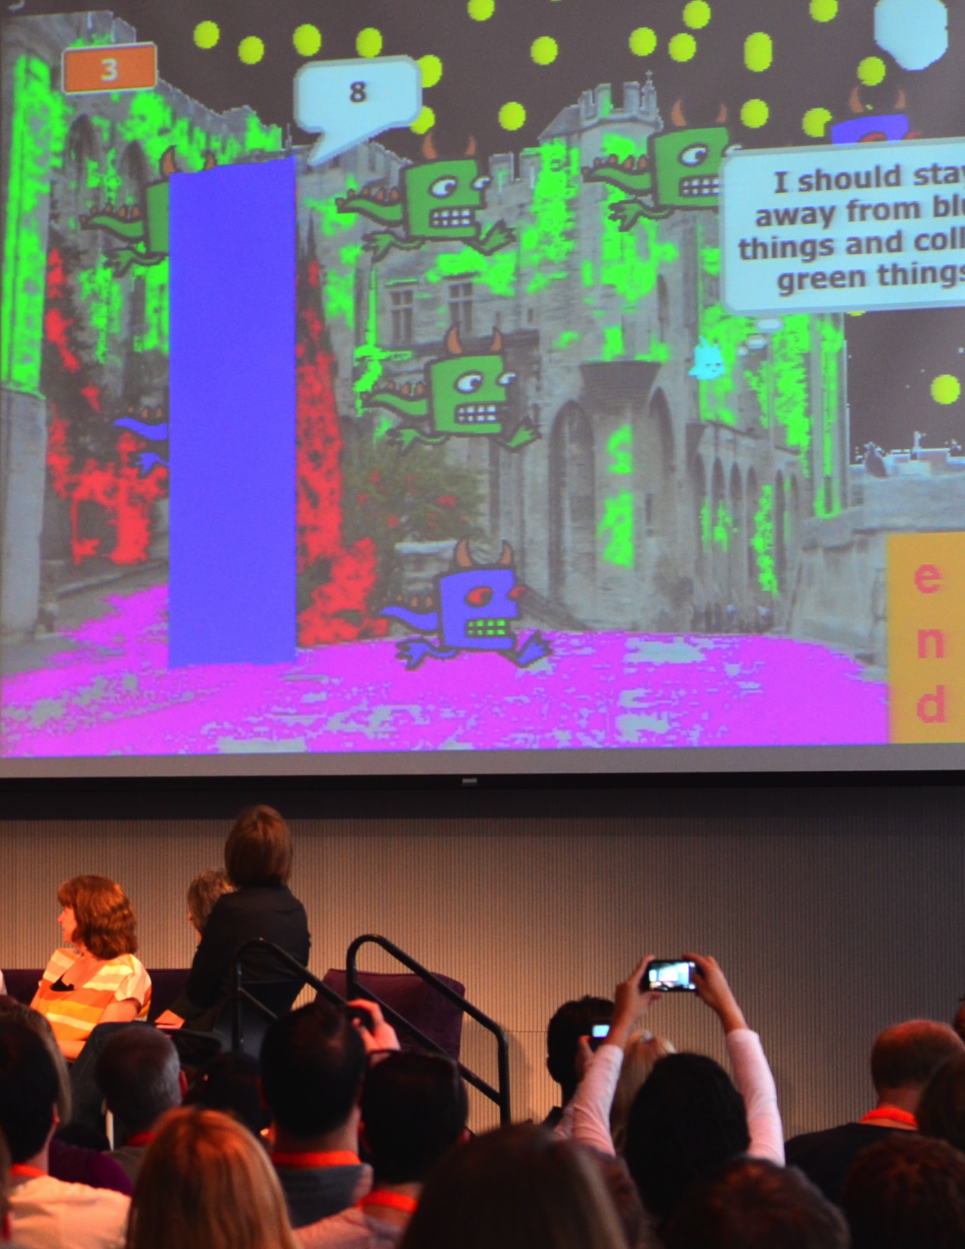
Notes:
<numéro>

Slide 24
132

